Slide 1
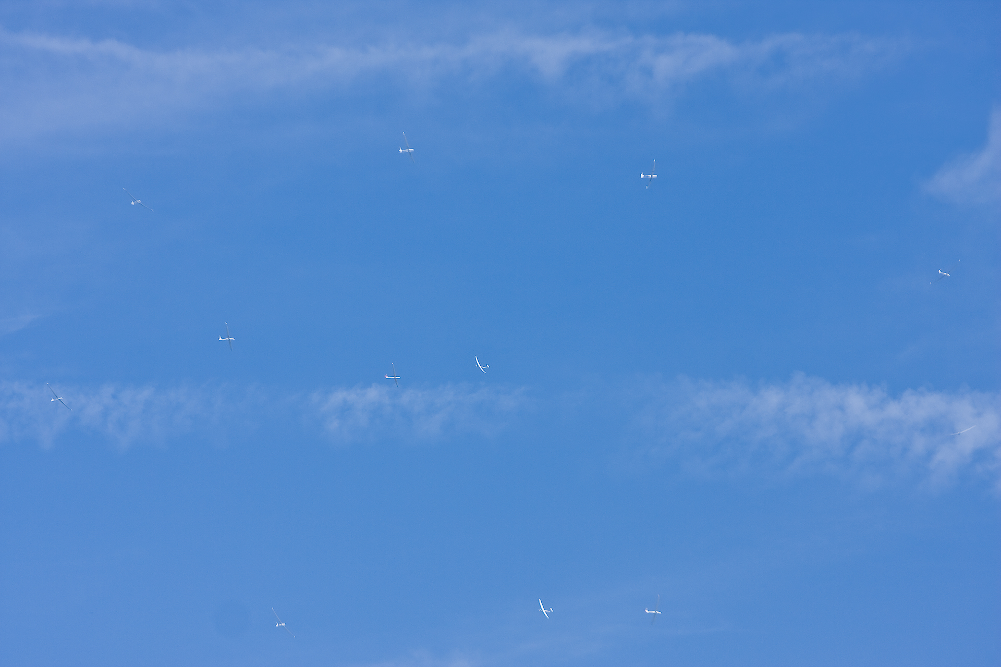
Cross-Country for Beginners
Part 3: Climbing—the art of thermaling
Bill Elliott and Rand Baldwin

Slide 2
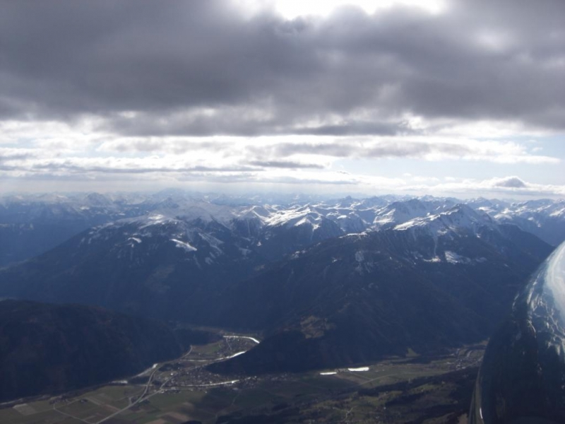
Six Week Agenda
  Weather and Preparation (needed skills, glider & instrumentation, biological)
  Thermals and Triggers
  Climbing—and the art of thermaling
  Cruising and In-Flight Decision Making
  Flight Computers and Final Glides
  Outlanding and Post-Flight Analysis

Slide 3
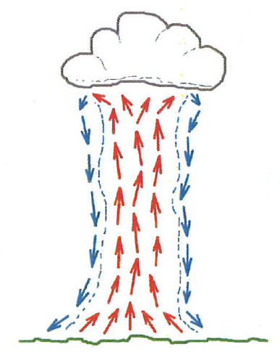
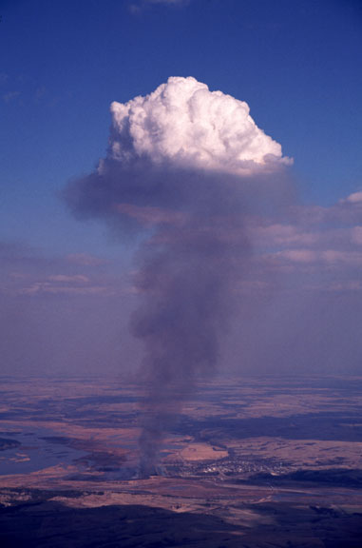
Review: Idealized vs. “Real” Thermal
BGD, p. 54

Slide 4
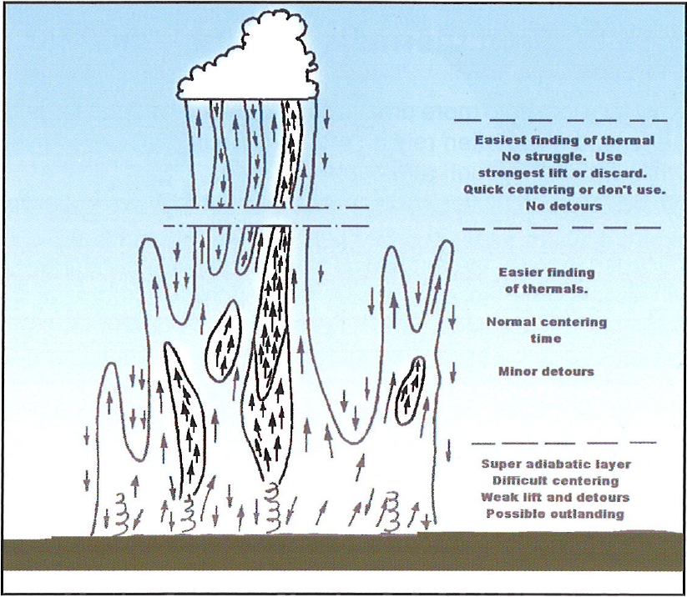
Thermals as f(altitude)
ASME, p. 35

Slide 5
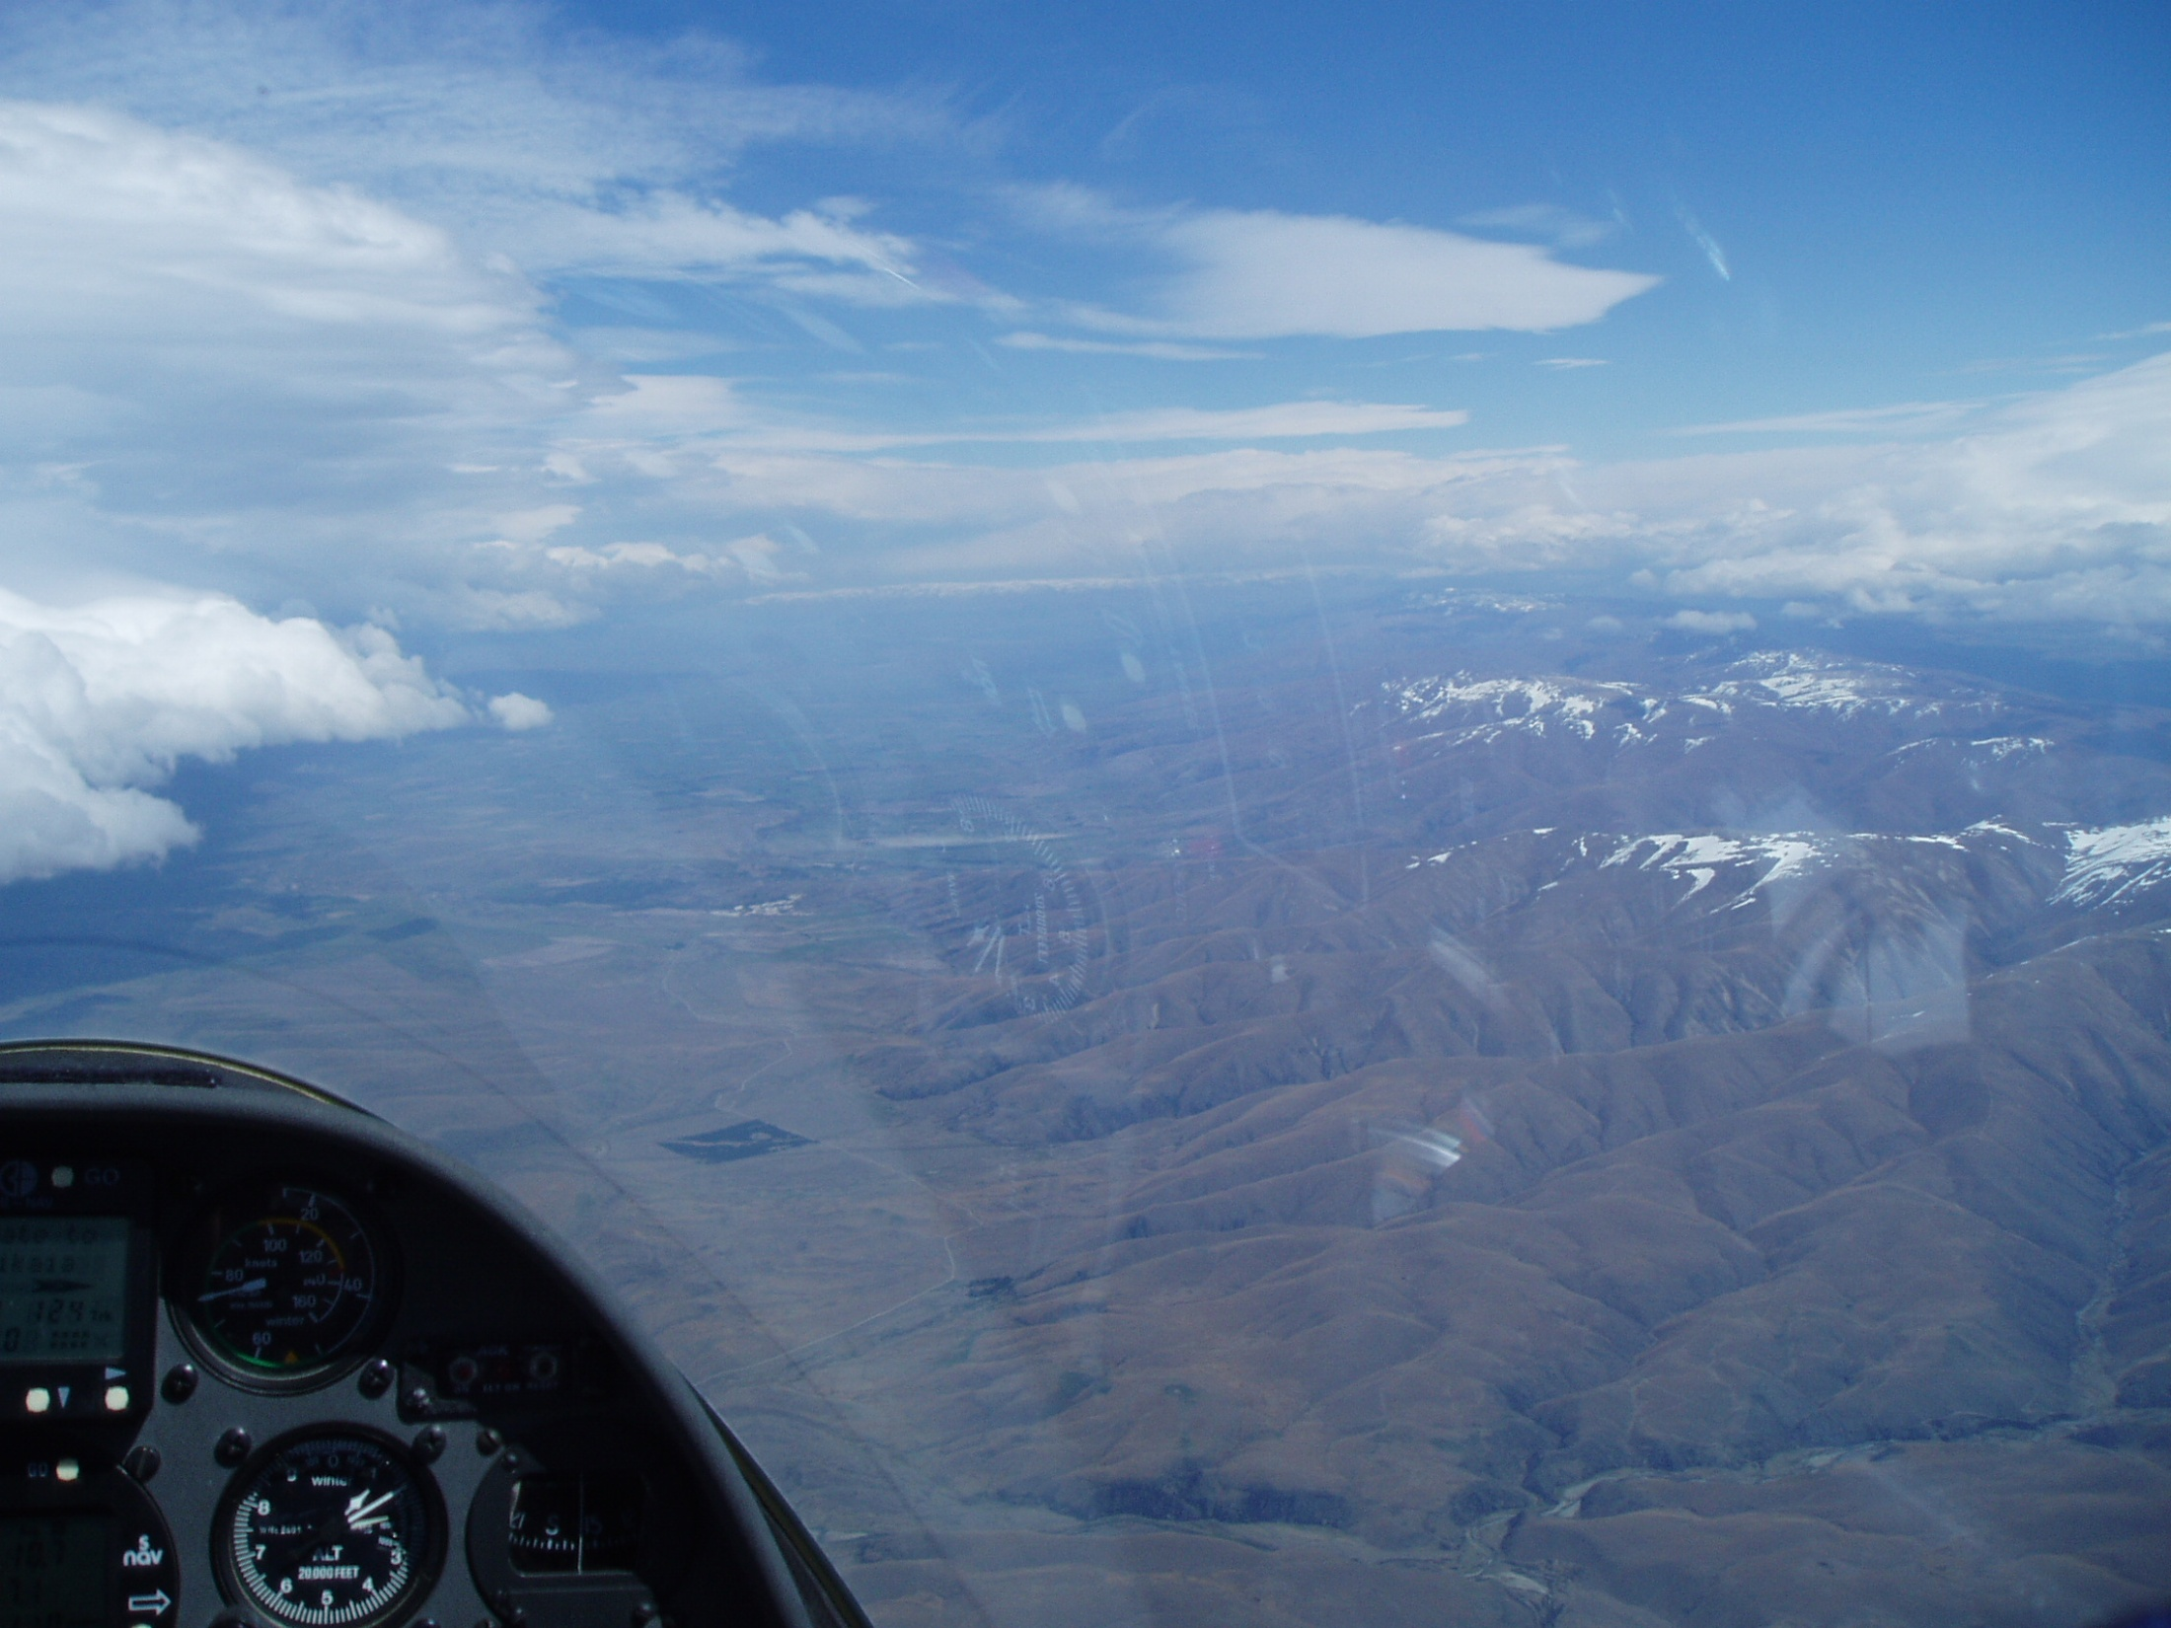
“Know Thy Winds!”
-- a quote from Gavin Wills --
What is the wind at altitude?
How do you know?
  Flight computer
  Drift of glider while thermaling
  Movement of cloud shadows on the ground
What is the wind on the ground?
How do you know?
  Smoke from small fires
  Wind signs on the water (ponds)
  Trash moving in a field
Are the winds the same … probably not.
Thermals will cause a distinct shift in the
wind direction on the ground so pay attention.

Slide 6
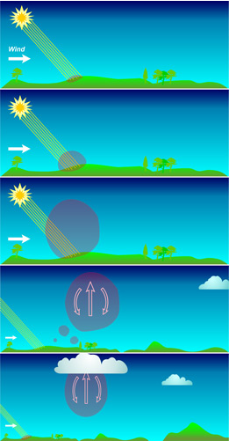
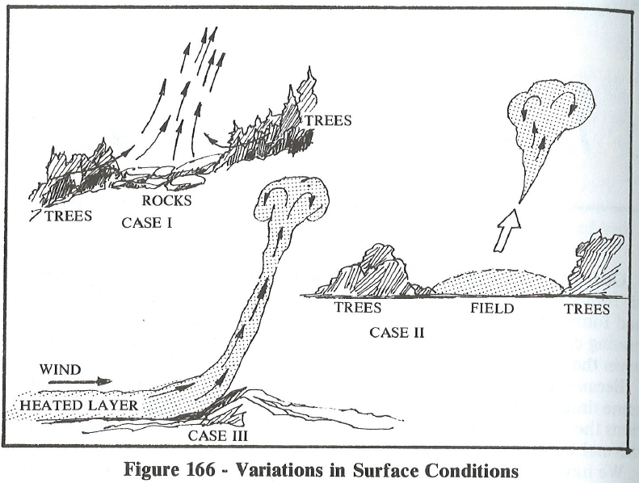
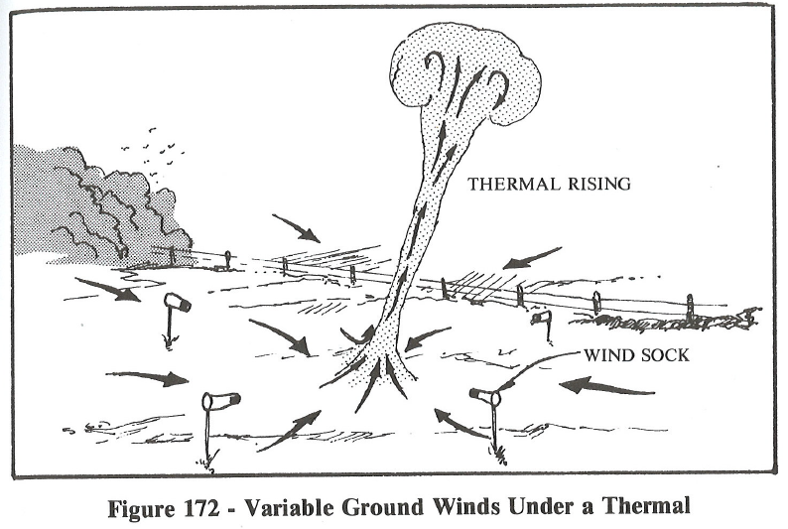
Thermal Triggers

Slide 7
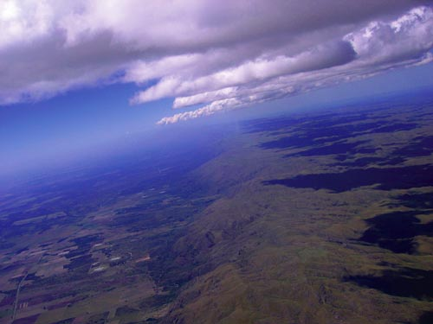
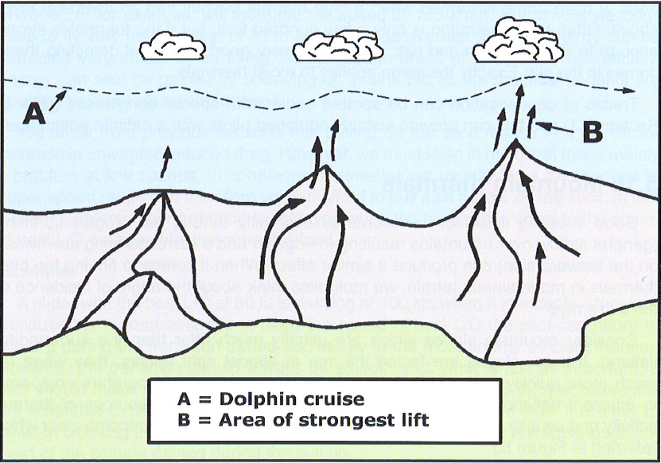
When in doubt …
… go to the high ground
ASME, p. 166

Slide 8
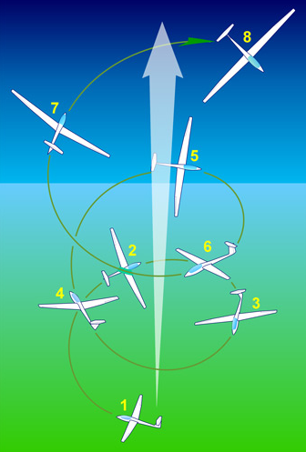
Today’s Agenda: Climbing
Understand the size of a thermal
Analyze required Turning Radius
Techniques for thermal entry
Discuss Centering techniques
Look at the use of PDA’s as an aid to Thermaling
Discuss how to find lift
Finding Lift on Blue Days
Thermaling Low
Observations

Slide 9
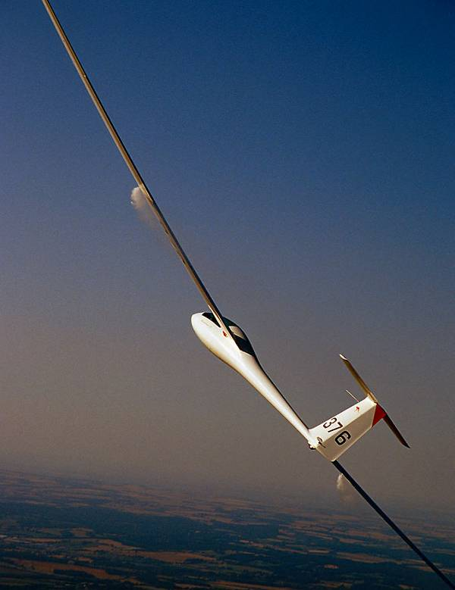
So how wide is a thermal?
Let’s mentally measure one
Glider going 60 kts travels approximately 100 ft/s
Let’s fly through some lift going 60 kts.
How many seconds … 4, 6, 8, 10?
200 Feet?
500 Feet?
1000 Feet?
2000 Feet?
Of course, thermals vary in size.
It would be a good estimate to so say thermals are roughly 600 to 800 ft wide (yes, they can be larger, and smaller)
with the core about 300 to 500 ft wide.
Notes:
Teaching point
Most don’t know how small a thermal is
Instructor pretends he’s a vario
Goes “beep, beep, beep” like an audio in lift for 10 seconds, which is a long time, class starts to laugh
Lesson? – see, thermals aren’t that big – they’re little

Slide 10
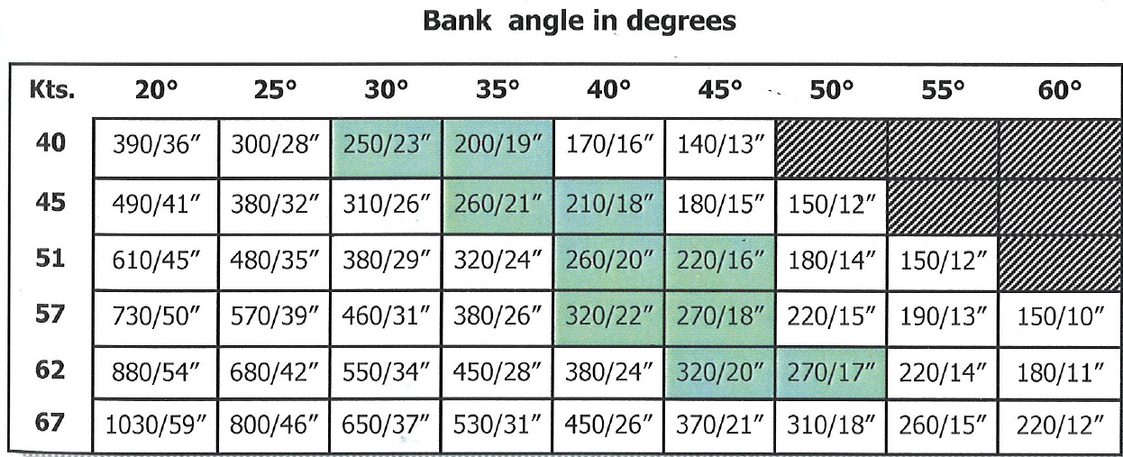
So, thermals are LITTLE!
Especially in the East—just a few hundred feet across
How big is the circle you fly?
In a modern glass ship, at normal thermaling speed:
20 degrees of bank = ~1000 foot circles
30 degrees = 600 foot circles
45 degrees = 500 foot circles
practical minimum = 450 foot circles
Turning Radius (feet/seconds)
BGD, p. 45
Notes:
Teaching point
So, to stay in, must make circle little to match
Bank angle critical in doing so

Slide 11
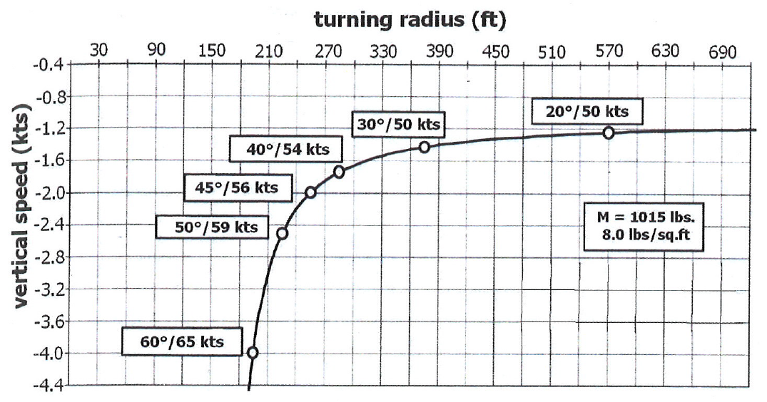
Optimal Turning Radius
Optimum is about 40 to 45 degrees or 18 to 20 seconds – keep your speed up!
Too little gain --
Increasingly more
difficult to control
bank and speed.
Best
< 500 ft
Better
Still Too Big
Too Big
•
•
•
•
Small increase in sink rate
Big increase in climb rate
Huge increase in sink rate
•
BGD, p. 45

Slide 12
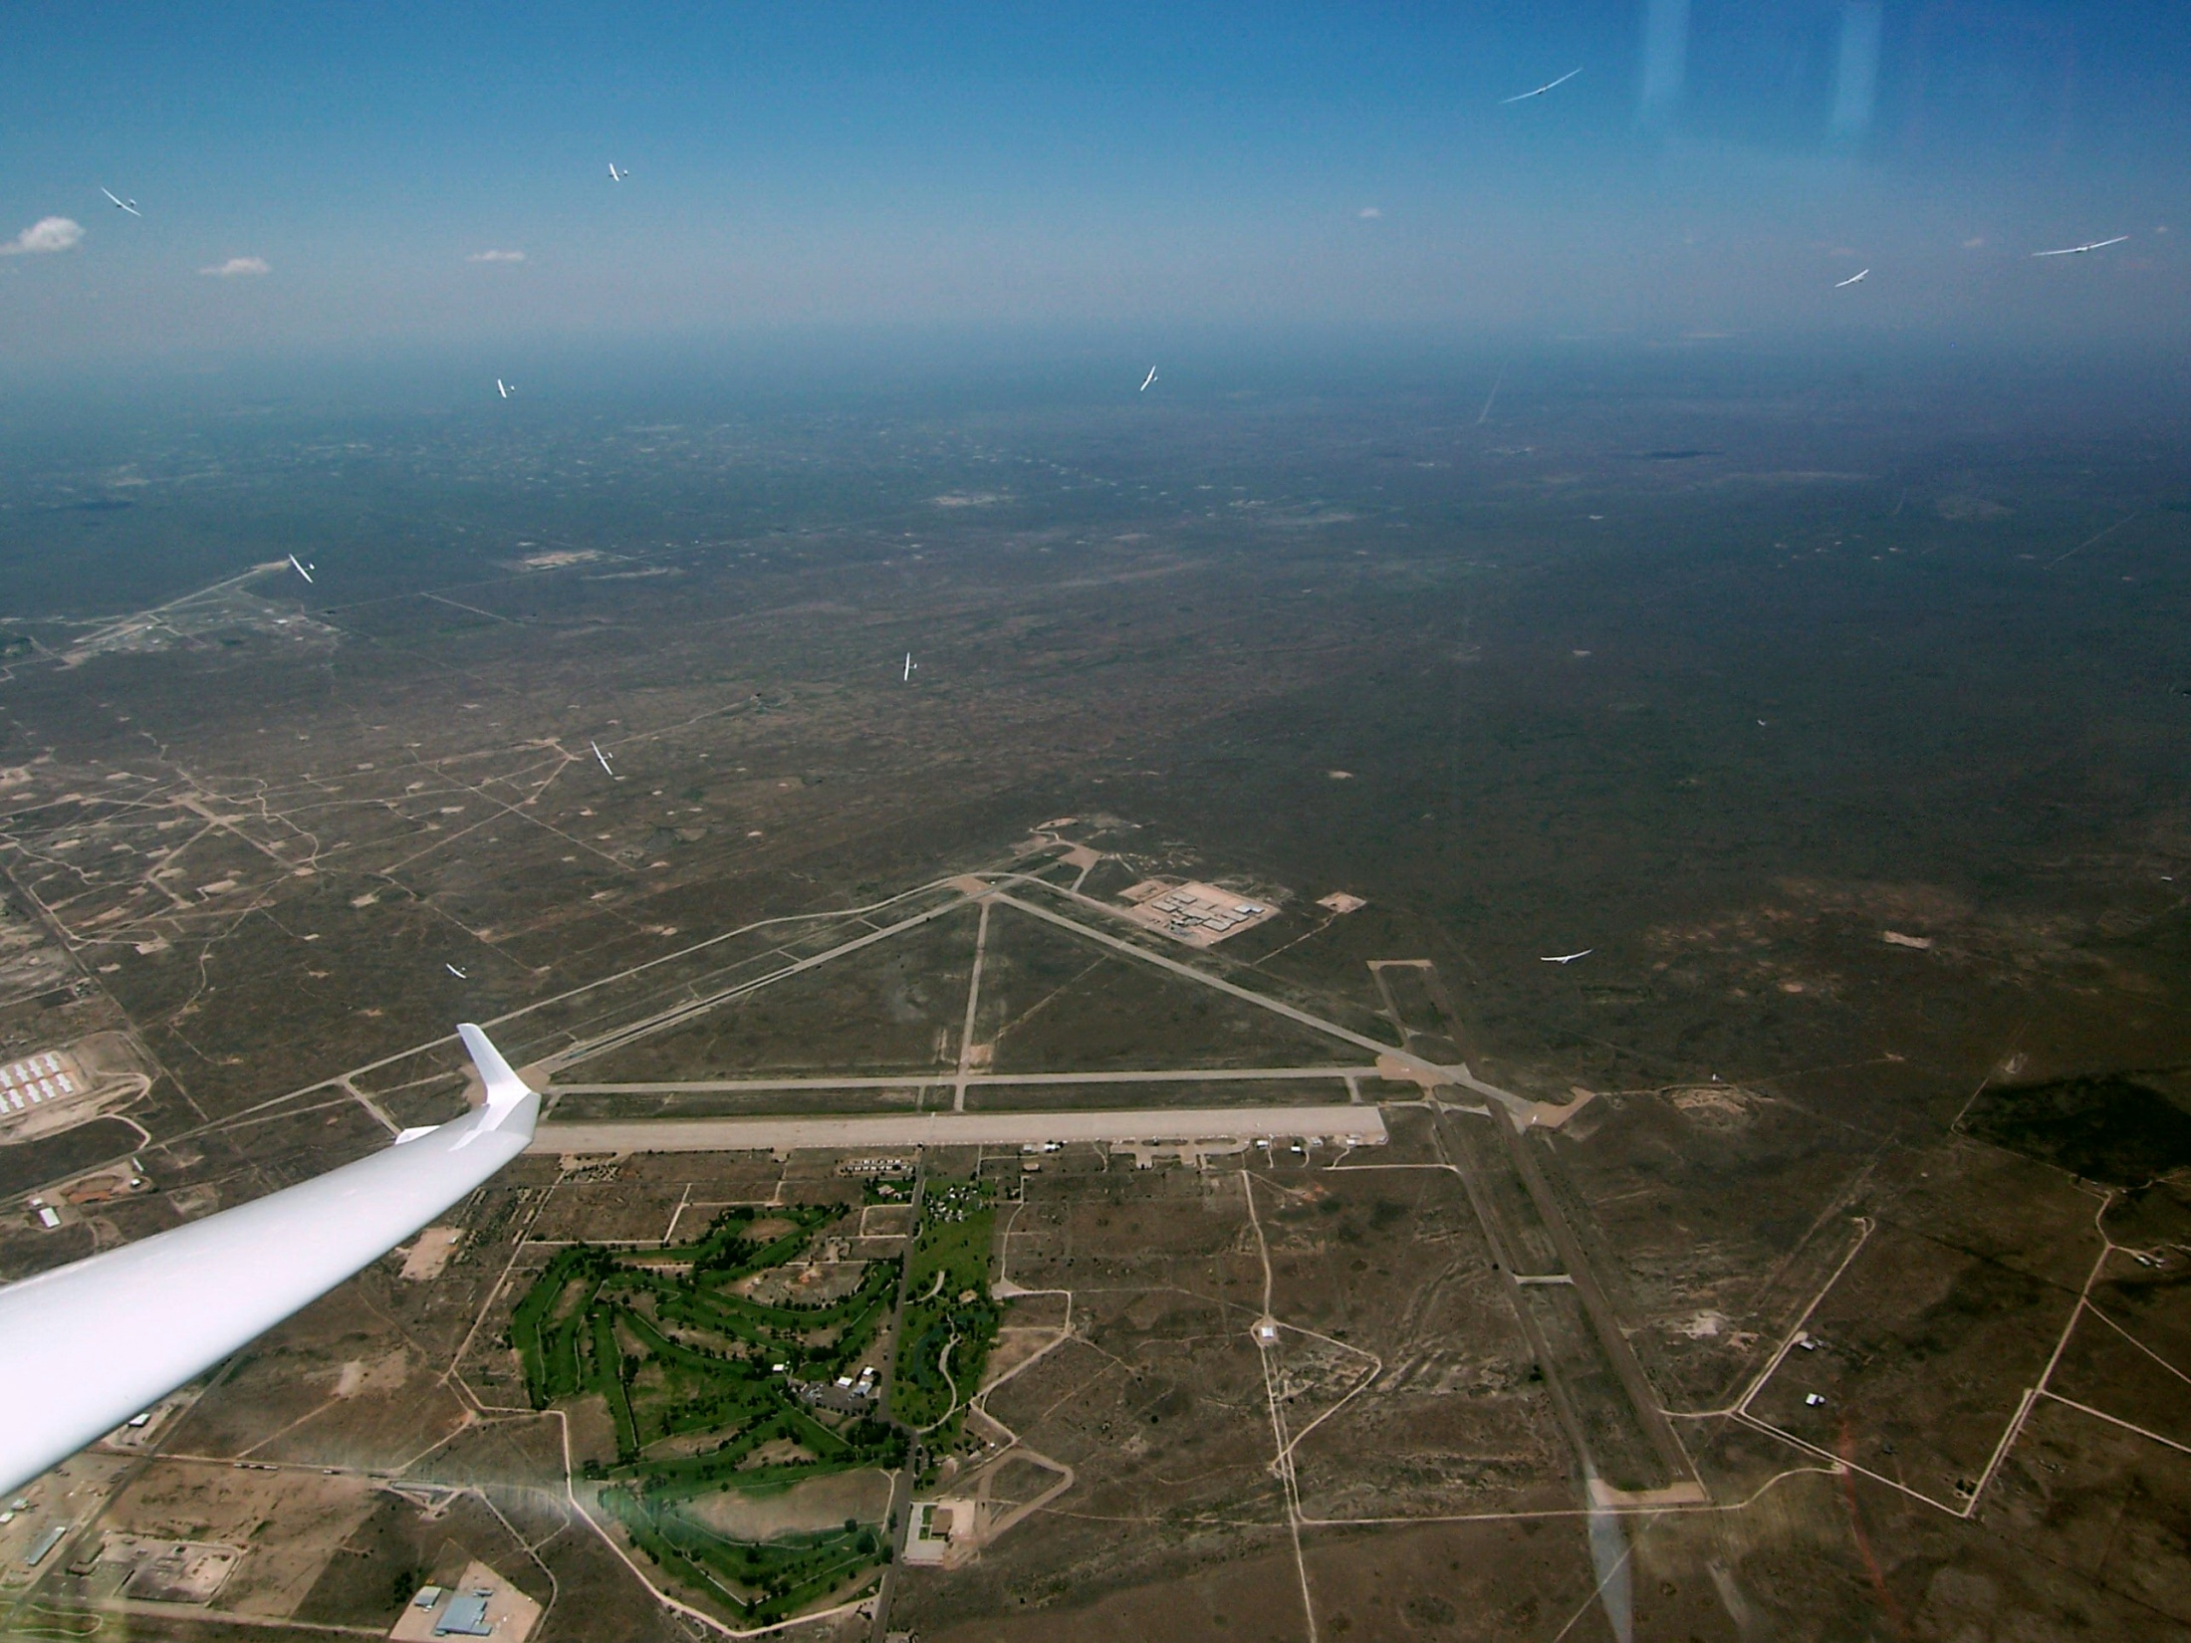
Things to Remember
Small Bank Angle Variations change the size of the circle a lot
Small Speed Variations change the size of the circle a lot
At small bank angles, small bank changes move the circle a lot
At high bank angles, large bank angle change needed to move the circle
Why the heck is this important?
  New XC pilots tend to fly too flat a bank
  And let their bank angle wander
  And let their speed wander
While Thermaling, Fly: Controlled pitch attitude and Bank angle
Notes:
Read the slide

Slide 13
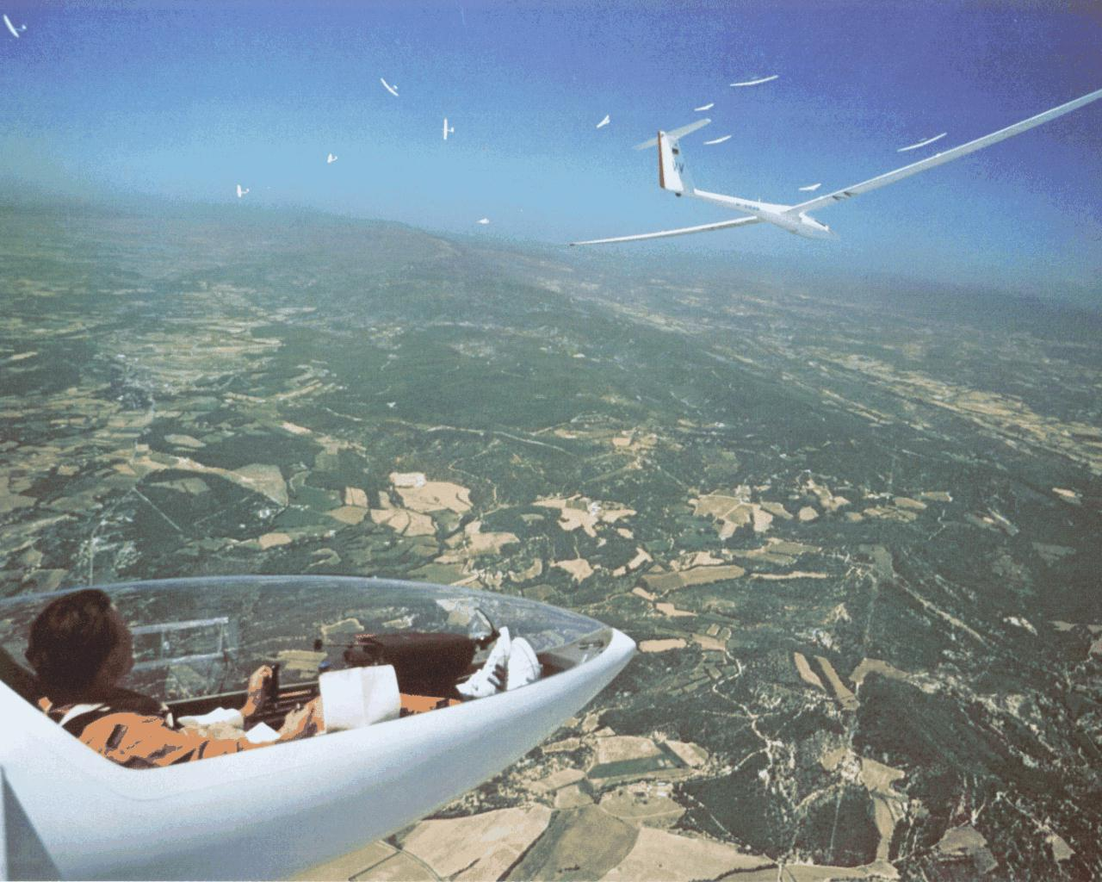
Joining a Thermal

Slide 14
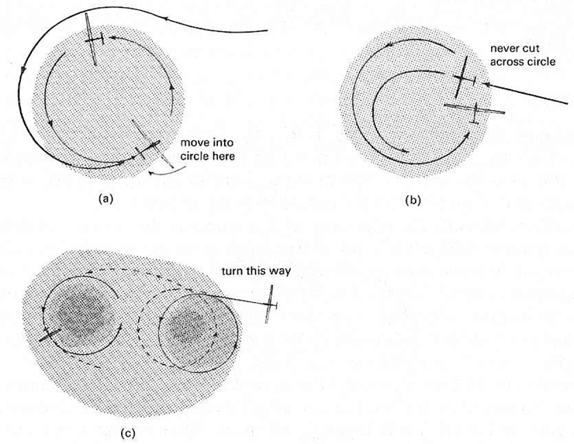
Joining a Gaggle
3
4
6
2
1
1
5
2
5
6
4
3
(a) Always join outside their circle and only move in when on the opposite side.
3
2
1
(b) Never join by cutting across another pilot’s circle
or pulling up into the circle.
3
1
2
(c) Always circle in the same direction as any nearby glider to make joining each other safe and simple.

Slide 15
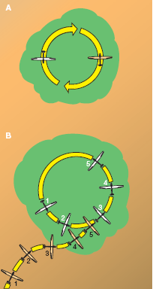
Thermal Entry/Exit
Enter from the side,
don’t aim for the middle
Vary your bank to fit yourself in
Turn in the same direction of the first sailplane in, usually above
Avoid just above or just below positions
Passing, avoid cutting across the nose of a slow climber
Don’t bomb through the center upon leaving, no matter what the books say
Notes:
Go through the slide

Slide 16
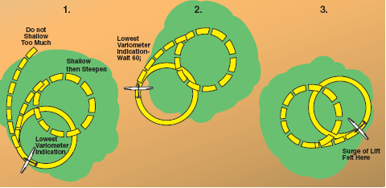
Classic Method: Bank Angle Change
Primary Problem for lower time pilots is flying past the lift, racking up in sink.
So, initiate the turn before the vario peaks.
Open up in Lift/Tighten up in Sink
When you know where the core is
Tighten up in Lift/Open up in Sink
When you don’t know where the core is
This assumes, I think, that you only have:
  A good Vario
  A good TE System
  Visual Queues
  A calibrated butt
However, you now have a PDA which can provide you a visual record of your flight path.
Notes:
Most experienced pilots do a mixture of this one
When encountering lift
rack into a turn
When hitting the sink
fly away from the sink
Requires constant hypotheses about where the core is

Slide 17
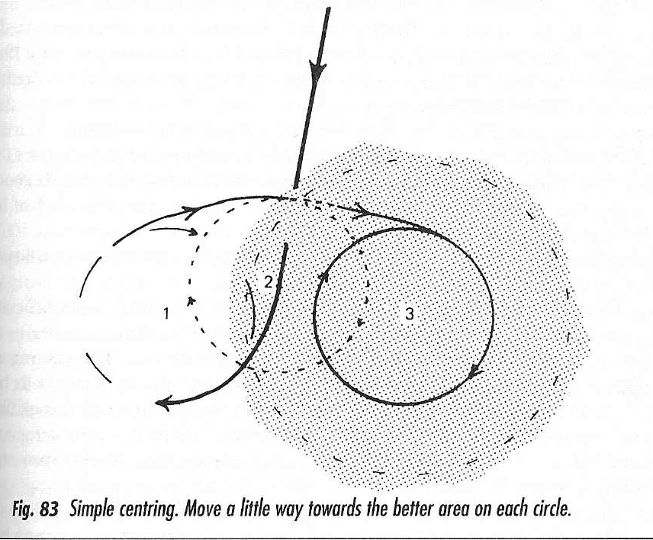
Simple Centering
Committing to a 40 - 45 degree turn,
rather than broad exploratory turns, will help you keep track of the thermal.
1. Contact Lift, Time Turn,
and Initiate 45 degree Turn
3. Adjust towards core,
keeping turns tight.
Never go through the same “bad air” twice!
2. No Lift—turned the wrong way;
but, you know where the lift is.
Adjust circle towards lift.
4. Never lose track of
where the thermal is.

Slide 18
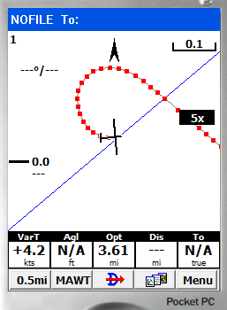
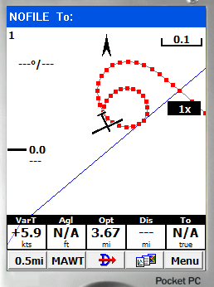
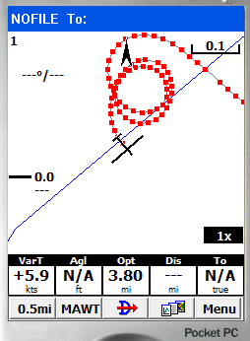
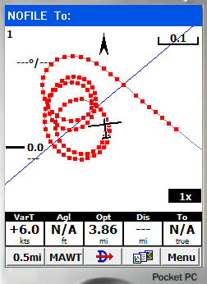
Use your PDA – Zoomed in!
First turn. Got an idea where the thermal is?
How about now?
Exploratory?
You only have to glance at the PDA for the information
I’ll bet any of you could find your way back to the core, huh?

Slide 19
Most Pilots Turn Too Late
A committed turn, even late, gets back to the lift more quickly.
Large, exploratory turns can just keep you out of the lift longer.
Committing to a 40 - 45 degree turn,
rather than broad exploratory turns, will help you keep track of the thermal.
Notes:
It’s actually easier to turn too late than this picture suggests since you may well encounter the thermal further to one side or the other but regardless of the actual trajectory, the time to turn is either on a good surge or immediately after the vario reaches its maximum.

Slide 20
Which Way to Turn?
This just takes lots of practice to get right – that is some of the time!
Sometimes, I feel like if I try to pick I am 75% wrong,
while simple always going left only makes me wrong 50% of the time.
Fly through the core,
Both choices are equal
Just off Center,
hard to detect best direction,
just commit.
Core is to the right,
Try to detect wing lift,
Much larger mistake
if wrong direction.
Notes:
The further the entry course line is from a diameter, the greater the cost of a wrong way turn. There is little to be done about this however since we cannot know on approaching a thermal where the center is.
A) No need to worry - both ways are wrong, and there is no way to distinguish.
B) Right turn is favored, but unless the right wing lifts prior to the turn, the pilot does not know this.
C) The sufficiently lucky or sufficiently skillful pilot can perfectly time the turn, get the direction right, and be centered almost immediately.

Slide 21
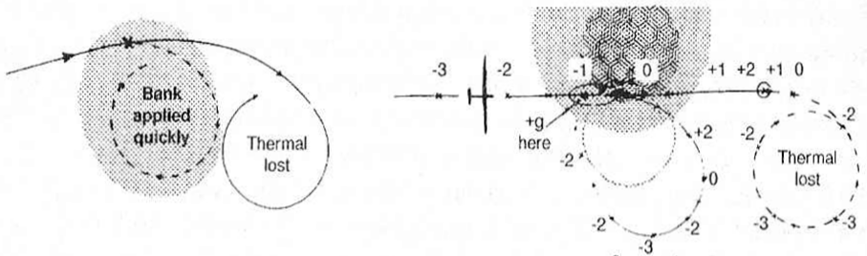
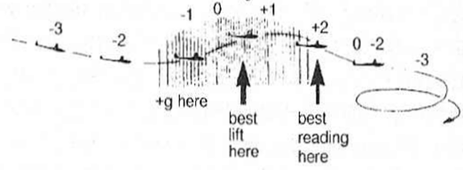
When to turn in Lift?
Top view
Side view
This illustrates yet again the advantages of turning promptly and applying the bank quickly.
Do not wait for the best variometer reading; rather, initiate turn on the surge.

Slide 22
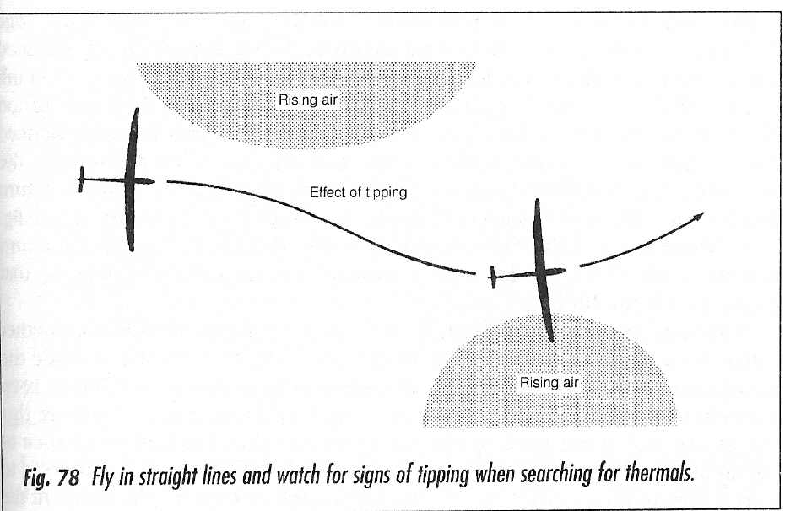
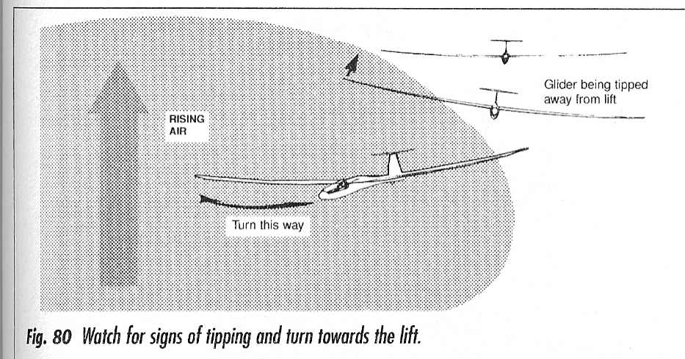
Finding Lift: Fly with a Light Hand

Slide 23
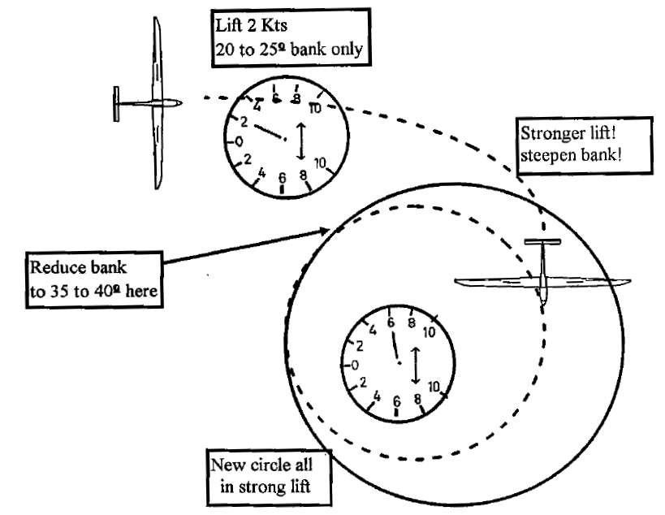
Huth Method: Opposite of Classic Method
FF&F1, p. 53

Slide 24
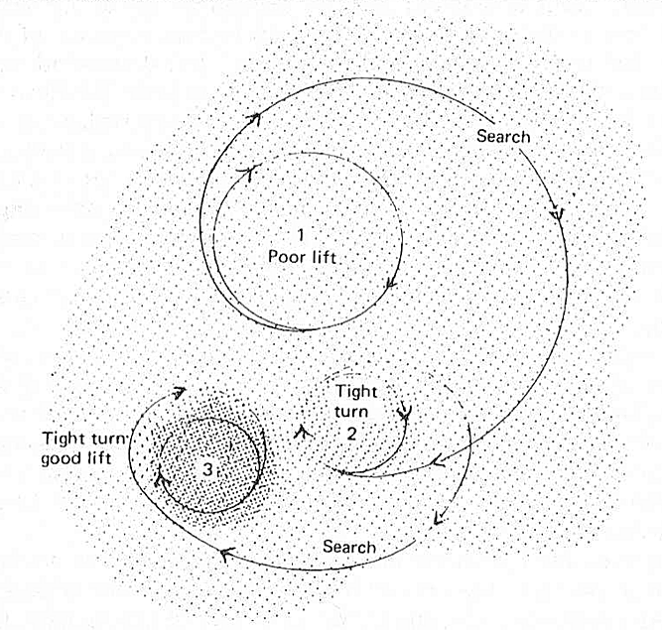
Another Tightening on the Surge Method
This can work well:
Under large Cu
With bubbles
When low
Note: this is another method advocating committing to a turn!

Slide 25
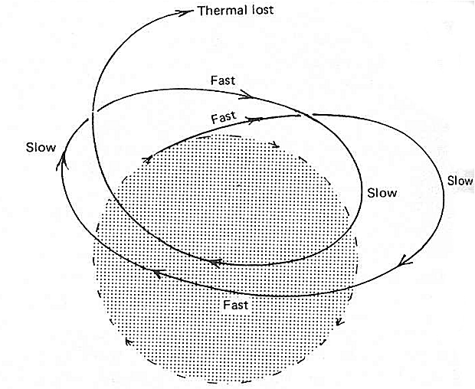
Too much Variation, Poor Flying
You must fly a constant attitude with bank angles you initiate—not banks initiated by the thermal!
Total Energy Systems,
even good ones, cannot keep up with changing speeds, accelerations, pulls and pushes.
The effects of varying bank and speed in a turn. The thermal will be lost.

Slide 26
Let’s look at some flight traces

Slide 27
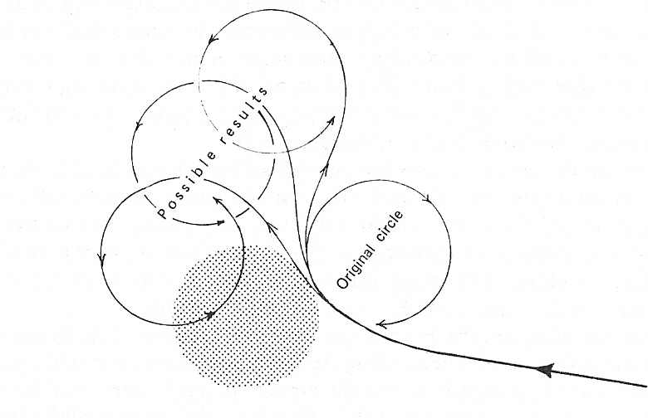
Never Reverse the Turn
You have no idea where the thermal is for at least one more turn.
Since you probably turned late, you are now way past the thermal.
… well, almost never – I do on occasion

Slide 28
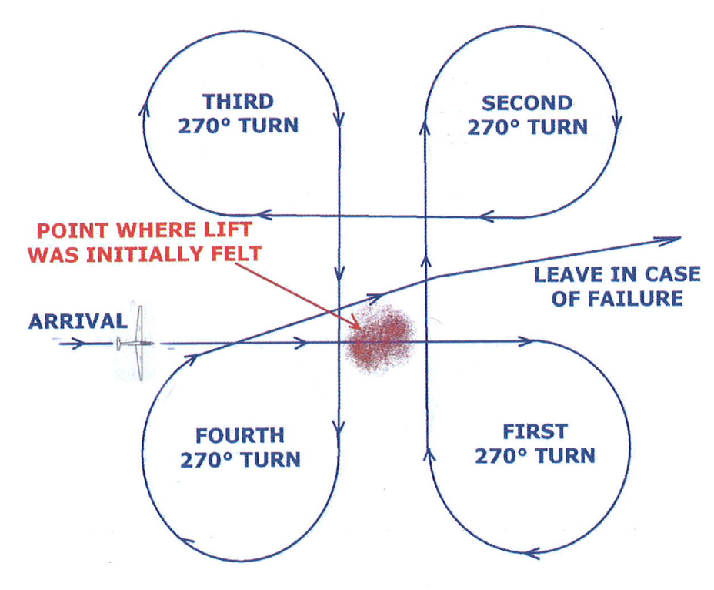
Searching for a thermal you’ve got to have
BGD, p. 108

Slide 29
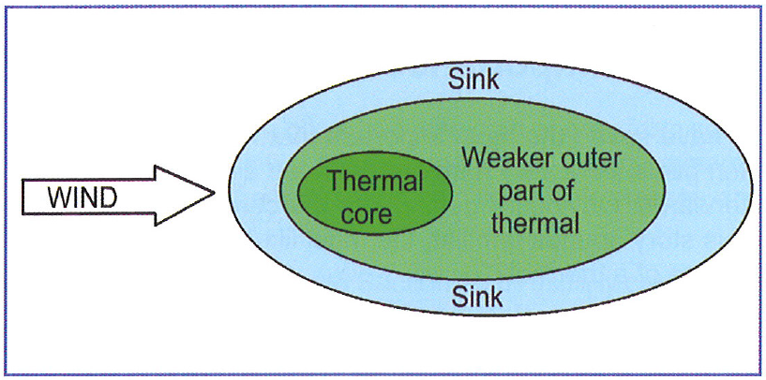
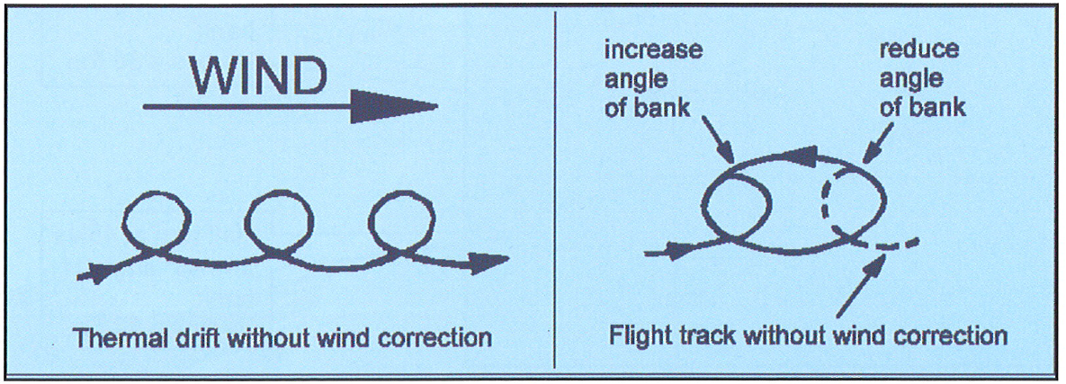
Thermal Cross-Section and Wind
The wind will often create oblong areas of lift with a shifted core.
Sometimes, continued upwind corrections are needed.
ASME, p. 51

Slide 30
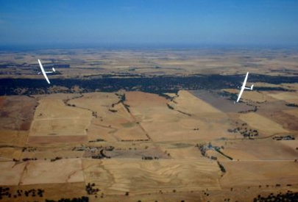
Effect of Gust on the TE Vario
Gusts change the KE of the Glider
The TE Vario measures the Energy of the Glider
Therefore, TE Varios are gust sensitive!
So, add a filter
  Pneumatic Filter
  Electronic Filter
  “Head” space Filter
You‘ve got to have a good vario and TE system
Notes:
Everything good comes with a price tag attached. The price we pay for T.E. compensation is gust sensitivity. It is easy to see why this must be so: Any gust which contains a component aligned with the relative wind (which is to say ALL gusts other than those which are either vertical or at right angles to the relative wind) will change suction on the T.E. probe. A gust which with a component on the nose of the glider will increase suction and cause a positive deflection on the vario. The converse is true for a gust with a component on the tail of the glider. Neither effect is small, and both make it much harder to interpret the vario reading.
I will have more to say about gusts and the TE vario in my talk on instruments but for now will note that the “noise” of a gust is in fact signal, and that the TE variometer is doing exactly what is was designed to do – faithfully determining the total energy of the glider which does indeed increase when it encounters a (positive) gust. To make matters worse the sensation (“kinesthetics” is the vogue word) of flying into a positive horizontal gust is indistinguishable from the sensation of flying into a vertical gust, or a thermal.

Slide 31
So, how do we find lift?
Fly under promising looking clouds
Fly over good terrain
Go to the sunny areas
Look for birds, corn husks, and large plastic sheets
Join other gliders in thermals
Search, but
  You need a search pattern between clouds
  And under the clouds
However, as always, Lift is where you find it!

Slide 32

Somewhat random but energy lines are visible

Slide 33
Finding Thermals: Lift is where you find it …
But you can improve your chances quite a bit
Cloud/cloud shapes
Wind direction, effect
Cloud cycle
  How far to that cloud?
  How long until it fizzles
Markers - use your eyes!
  Gliders
  Birds
  Dust/smoke
Ground surfaces
Sun/ground angles
Trigger points
  Ridge tops
  Vegetation changes
  Lake borders
Develop a mental profile of the day
Develop a feel for lift on your wings
And don’t do this
Notes:
Thermal search
Become a student of clouds
Know cloud cycle from the ground before you take off, from climbing before you start your task, get mental image of start-middle-end of cloud development
LOOK – pilots I ride with just don’t see as much as I think they should – lots of clues are missed
Fly the heading you want to fly, fly straight lines, else the lift will push you around through sink

Slide 34
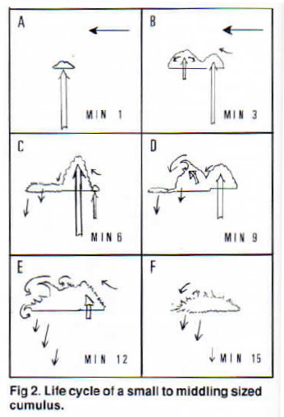
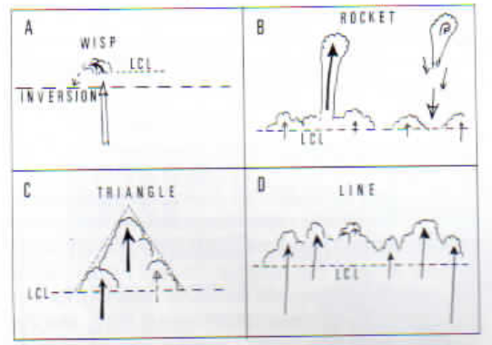
Looking for Lift
Small Wisps last about a minute.
Towers maybe 10, then collapse.
Triangles indicate good Cu.
Lines generally form over ridges.
Some research with powered aircraft suggests that in a field of cumulus cloud only about 10% of the cloudy air contains useful lift.
When there is a lot of moderate sized cumuli one can expect at least half the clouds to have little or no lift under them when you arrive.
Looking for Lift, Tom Bradbury, S&G, Oct/Nov 93

Slide 35
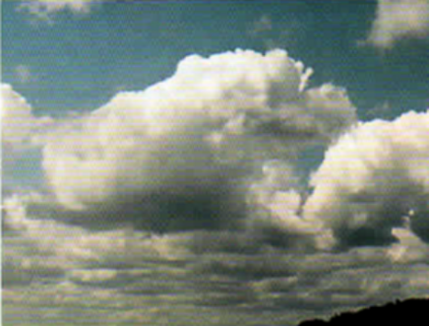
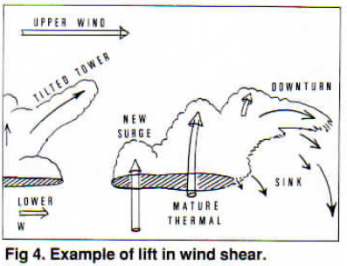
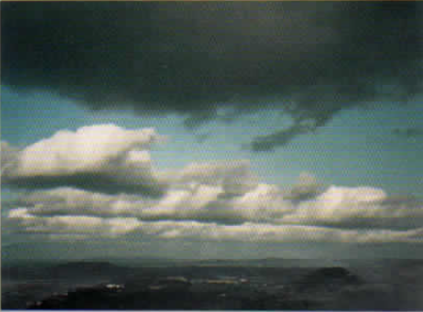
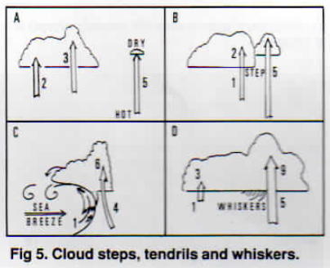
Reading Clouds

Slide 36
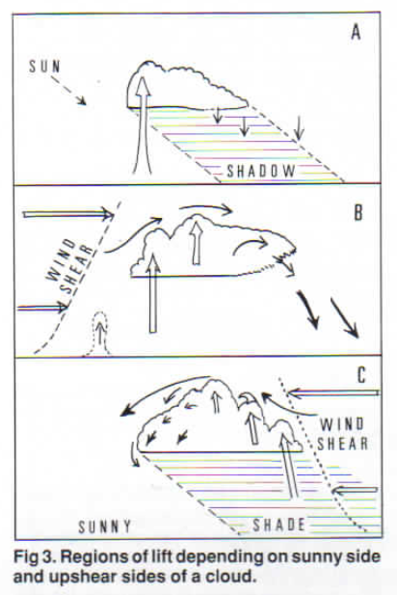
Some General Rules
Most small and medium sized cu have a short active life so one needs to have an alternative cloud In mind for times when the original choice proves dud.
Lift Is more likely on the sunny side of a large cu.
Lift is often found on the windward side of cumuli, especially if there is an increase of wind speed with height. This shear almost always produces lift at the upshear side and sink at the downshear end. Time lapse films show that in strong winds these clouds have a rolling motion, rising on the windward side and descending on the lee side.
If the upshear side is also the sunny side there is an even better chance 0f finding the lift entering there.
If the sun is on one side but the wind shear is on the opposite side the odds seem to favor the upshear side. Lift then works best on the cloudy side but it may have a zig-zag pattern distorting the lift.

Slide 37
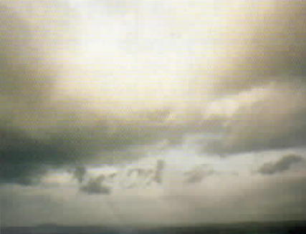
Some General Rules (cont.)
Shower clouds lend to produce a gust front blowing out ahead. The gust front triggers off new thermals so the cloud moves partly by setting off new areas of lift in front of it. As the cloud shadow arrives, new thermals may be triggered all. This seems to work even if the cloud is not large enough to give a shower. Pilots tacking up and down a ridge often find they can at last get away when the shadow of a big cloud arrives.
No set of rules can cover all the possibilities: one may find lift in unexpected places. The flanks of a big cumulus line sometimes give weak lift in clear air. This seems to occur when the cloud is growing; if the cloud line is near your planned track it is a splendid bonus.

Slide 38
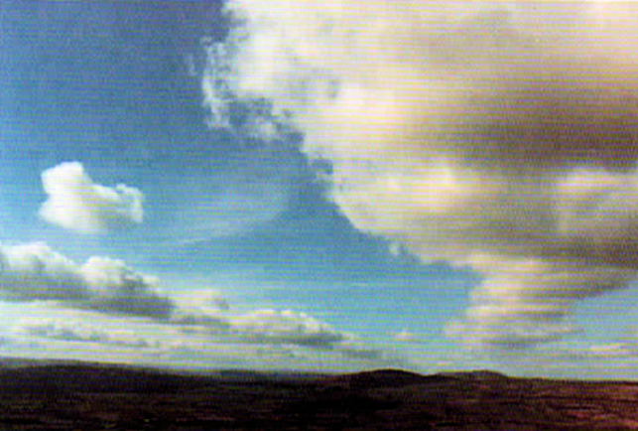
Some General Rules (cont.)
Try to "follow the energy" by flying under as many good looking cu as possible without making a major diversion.
Flying straight down the track marked an a map may look shorter but turn out much slower if you meet heavy sink out in the blue between cloud lines.
Lift is not confined to well established cu. It may surge up under you in unexpected places such as gaps in a cloud line which are about to be filled in by new thermals.
Finally, do not be impatient to set off for Silver distance the moment thermals start. Morning cumuli are often short lived and difficult to work. By mid afternoon cumulus nearly always have a higher base and longer life. The thermals are larger and easier to work. Many pilots have found themselves down in a field within twenty miles through starting too soon.
Remember: Lift is where you find it!

Slide 39
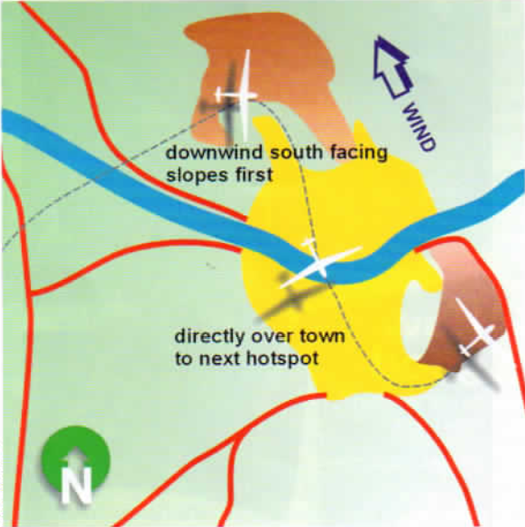
Find Lift on Blue Days
Look for the “Hot Spots” and
Identify the best trigger sources.
Fly the infrastructure
Fly the trigger points
Look for wind shaded,
south-facing areas
Go to any High Ground
Look for all the same signs as if you are low
Look for Haze Domes
Remember, streets form on blue days too.
Blue days can be just as fun as days with Cu

Slide 40
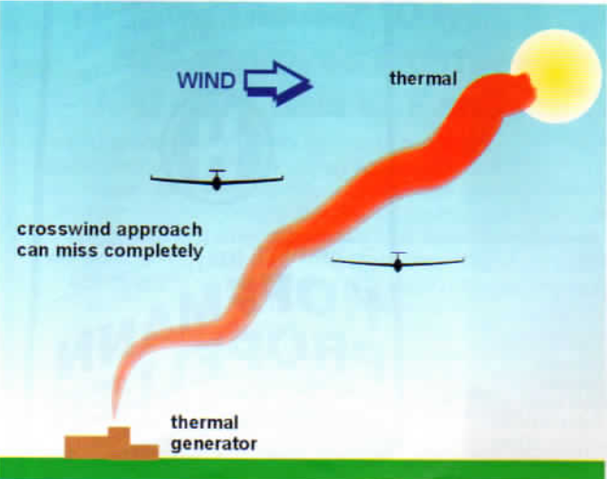
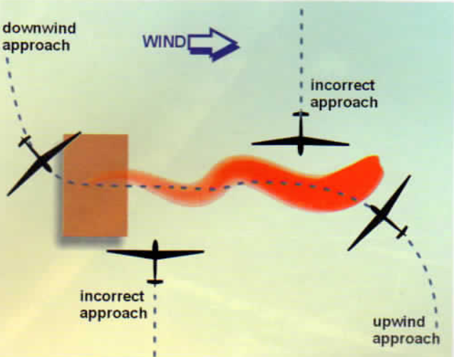
Know Thy Winds!
A crosswind approach minimizes your probability of contacting the lift.
Fly upwind or downwind of likely thermal source to fully explore area for lift.

Slide 41
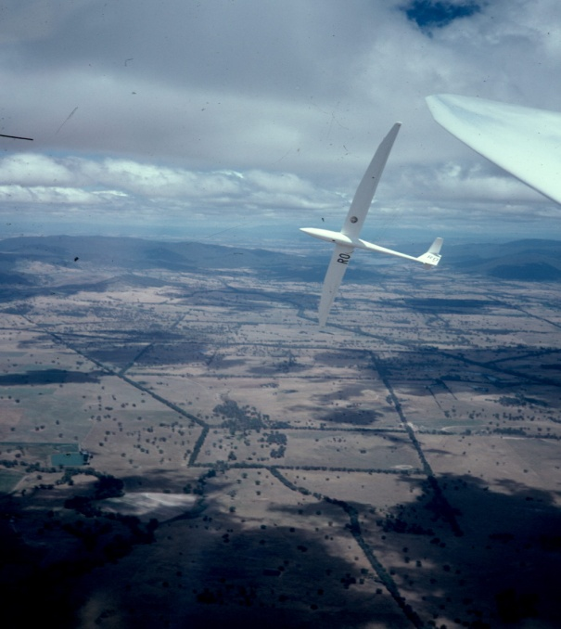
Things to dwell on while you thermal
  Get to the center quickly and stay there
  Refuse to fly through the same sink twice
Be prepared to adjust the circle continuously
Choose speed/bank angle yourself
  Don’t let the thermal do it for you
  Attitude constant
Look out the window for clues, look up – straight up:
  Above – emerging wisps, new cells
  Level – birds, gliders, debris
  Below – birds, gliders, dust devils, swirl patterns on leaves
Determine where to go next – before you get to cloudbase – pick out a landmark.
Stay off the radio
  This is hard enough as it is, and
  We haven’t even got to the decision making on where to go next
Notes:
Go through the slide
Particular emphasis on speed/bank angle
LOOK UP – amazing number of pilots do not look where it would be most advantageous to look in a thermal – straight up – that’s where cloud and wisp development will tell you a lot
Thermalling is hard work – don’t distract yourself with radio calls, map reading, pee bags and the like
Justin Wills quote “If you can make a radio call and thermal at the same time, you haven’t optimized the thermal

Slide 42

Thermaling Low
Low saves are a fact of soaring
Routine in ridge flying
Very difficult much below 1000 feet – and that’s for experts
Typically very narrow with sharp boundaries between sink and lift
Typically very turbulent
And dangerous as hell with any wind speed
So:
● Have a field picked
Add a bit more speed
Expect to be in and out of sink
Look for positive average climb
Stay with what you got – it’ll probably get better
Make small circle adjustments
Remember, look outside. Look for:
Birds or other gliders circling,
Change in wind direction on the ground,
Dust devils, Fires, Tractors,
Newly forming clouds
Find the trigger, go to the high ground.
Notes:
Getting low is a fact of life
Prepare for it
Stay calm
Stay with lift and wait for it to grow

Slide 43

Practice (as usual) makes perfect (or at least safer)
Routinely practice the following at the end of the day with any excess altitude (well above pattern, of course, and after clearing turns)
18 second circles, 55 knots, 45 degree bank
15 second circles, 65 knots, 55 degree bank
Enter/Exit/Change Direction
Rigid Adherence to constant speed/bank angle
Yaw string in the middle – no “speed brakes”
Note constantly change in required rudder position for bank angle. Most pilots under rudder when they increase bank and over rudder when they reduce bank.
Get to Know your Airplane – It’s easy to spin from a tight turn
Notes:
Must have full command of the glider and practice makes perfect
Most glass gliders WILL spin, contrary to popular notions. Try this in yours – well away from everyone – you’ll be surprised. But then you’ll recognize and be able to avoid

Slide 44

Practical Observations . . .
From Thermals I’ve known
Strong lift goes high
But interthermal distances are large
so don’t get low
Weak lift goes only to moderate altitudes
But tends to be more generously distributed
Thermal strength varies quite a bit
One out of five are best
Avoid the weak ones except in need
There’s an optimal XC height band
Top 2/3rd’s of the convection band is workable
Top 1/3rd is the fastest
Notes:
Read slide

Slide 45
Six Week Agenda
  Weather and Preparation (needed skills, glider & instrumentation, biological)
  Thermals and Triggers
  Climbing—and the art of thermaling
  Cruising and In-Flight Decision Making
  Flight Computers and Final Glides
  Outlanding and Post-Flight Analysis

